Slide 1
Session 7
Expect the Unexpected – Curiosity,
Reflection, and Creativity in Libraries
Dianne Cmor and Jeff Trzeciak

Slide 2
Expect the Unexpected Curiosity, reflection, and creativity in libraries
Dianne Cmor
HKUL Library Leadership Institute 2018, Hong Kong

Slide 3
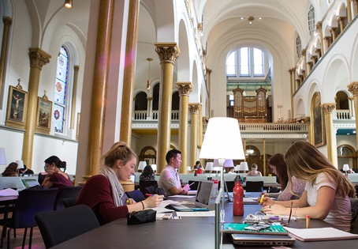
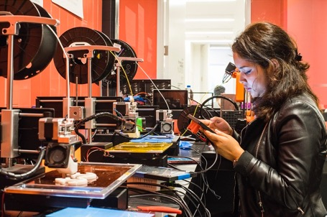
Library spaces . . .
Learning spaces
Discovery spaces
Community spaces
Technology spaces
Creative spaces
Inspiring spaces

Slide 4
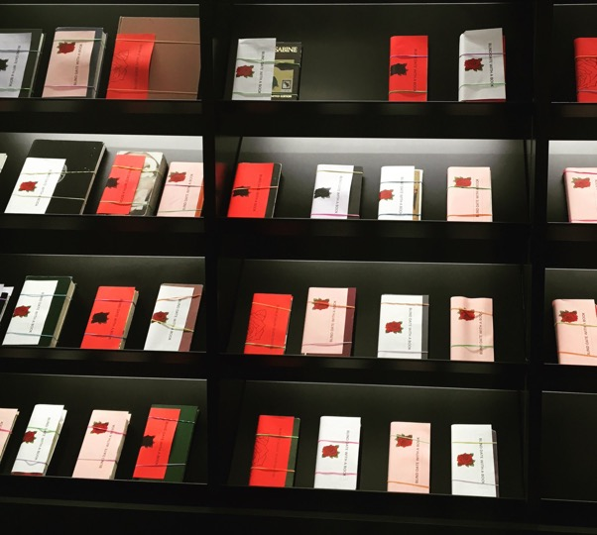
. . . Engaging the mind
Engaging events
Engaging exhibitions
Engaging technology
Engaging collections
Engaging services
Blind Date with a Book

Slide 5
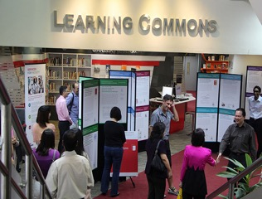
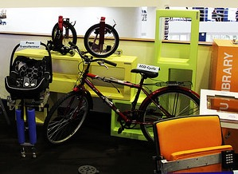
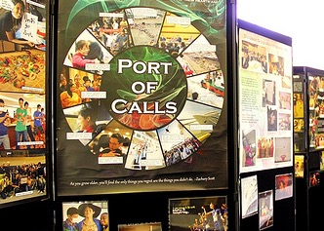
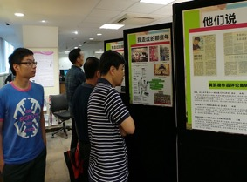
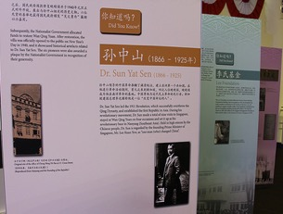
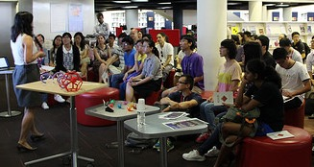
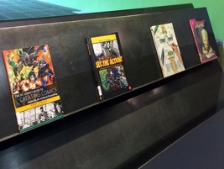
Engaged Learning in the Library

Slide 6
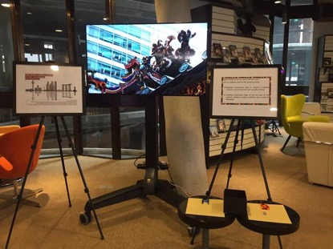
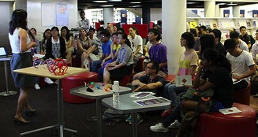
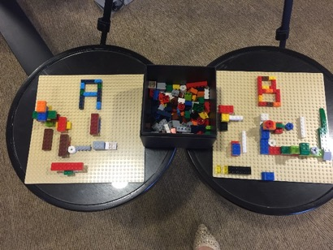
Sample methods of engagement
Reflection element for displays/exhibitions
Activities & play added to academic talks
Daily Discover or Poll of the Week
Living Lab (research or innovation)
Student-run activities
Student-supplied content

Slide 7
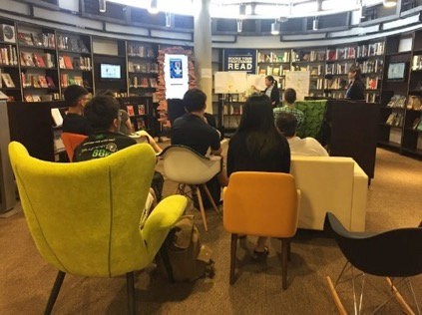
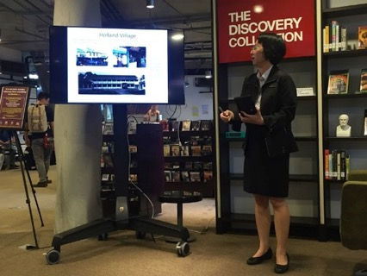
Take a break, and learn something completely unexpected …
Notes:
Our most ambitious example, is our Daily Discover.
Yep – everyday. EVERY DAY.
We are not looking for big crowds everyday, but small intimate gatherings. We are looikng to become known as the place where learning is happening all the time, where students can take a break from their usual studies and learn something completely unexpected. It’s only 19 minutes long – so who can’t afford that??
Did a mention that this is a DAILY discoer?
We may be crazy. However, we have a couple of strategies that we think can make it rather doable …

Slide 8
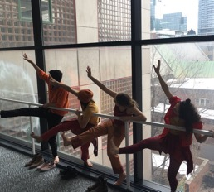
Sample foci of engagement
General education
Scholarly activity
Civic engagement
Community focus
Innovation focus
Creativity focus
Technology focus
Reading focus

Slide 9
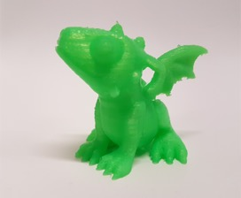
Technology Sandbox
Notes:
Nerdy-math-crafting

Slide 10
Edible Books

Slide 11
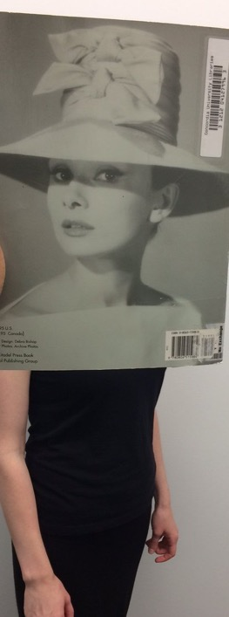
#Bookface

Slide 12
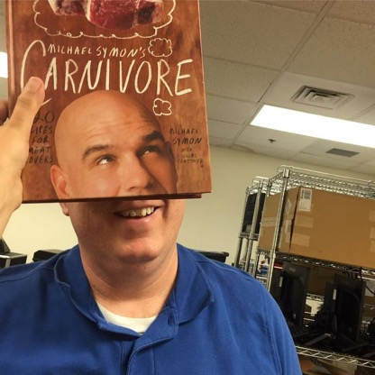
Build a hunger for learning …

Slide 13
and then feed it!

Slide 14
Have fun out there … !
Dianne Cmor
HKUL Library Leadership Institute 2018, Hong Kong

